Slide 1
ANSI MH10.8.7 and MIL PRF 61200A Adhesion Testing Methodology Analysis
Allan Gilligan
A & N Associates

Slide 2
Testing Structure
Test for compliance to minimum adhesion requirements
Duplicate the adhesion test using the ANSI MH10.8.7 test methodology and the MIL PRF 61002A test methodology
Test using different label materials to insure that material choice does not influence the test methodology
Test each label set and condition in triplicate
Testing was done in a laboratory accredited by the American Association of Laboratory Accreditation (A2LA) with Allan Gilligan guidance

Slide 3
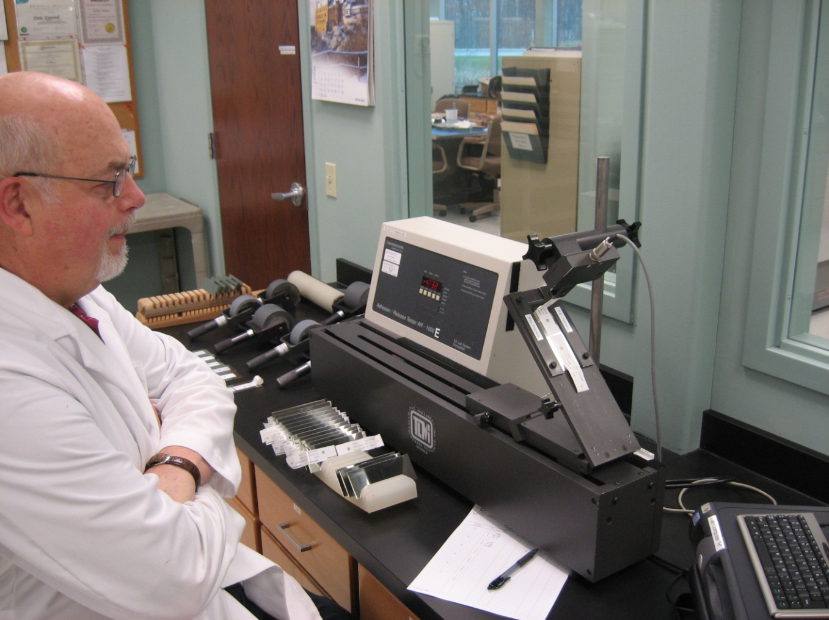
90 Degree Peel Testing Device

Slide 4
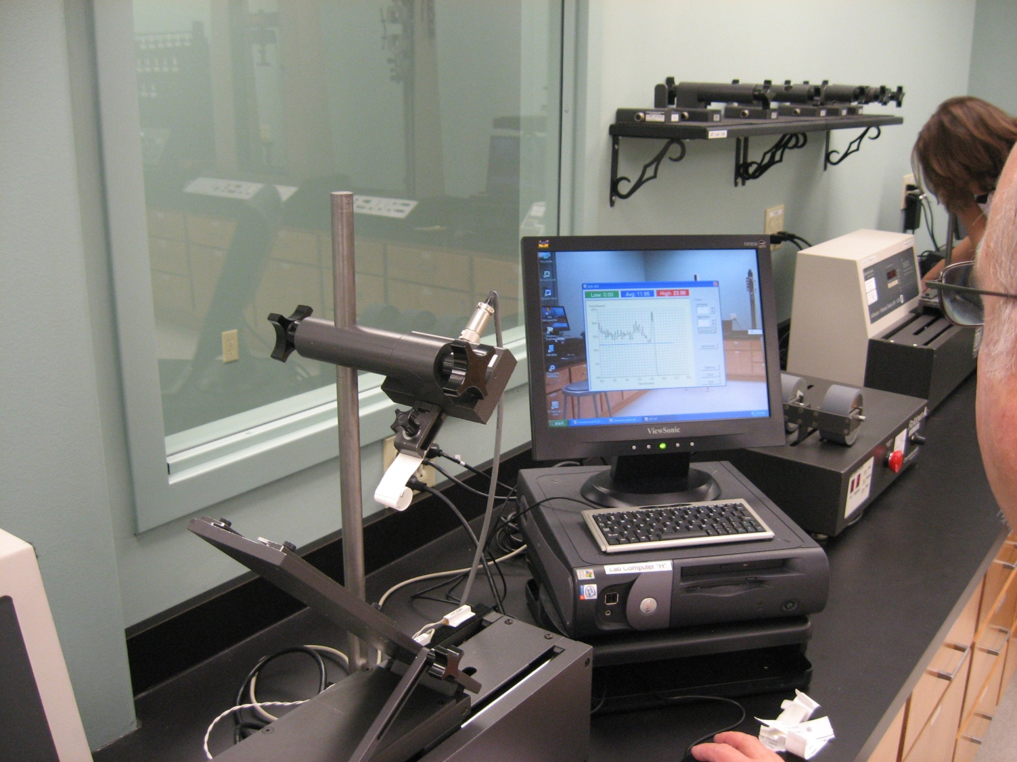
90 Degree Peel Testing Device

Slide 5
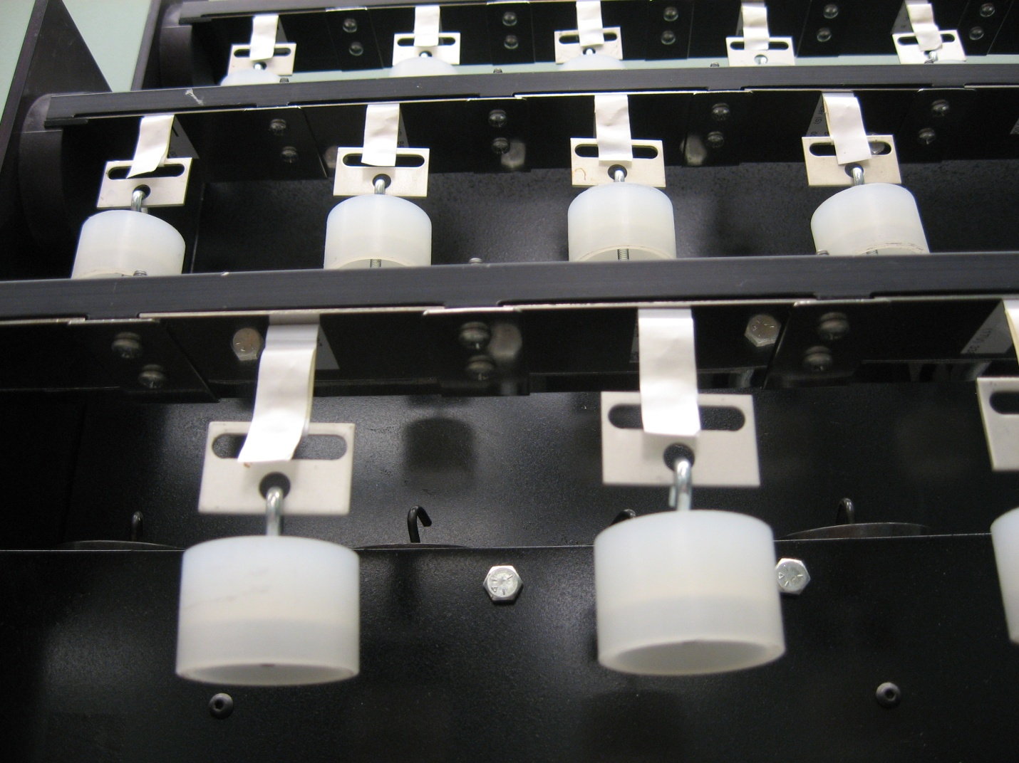
MIL PRF 61002A Testing Device

Slide 6
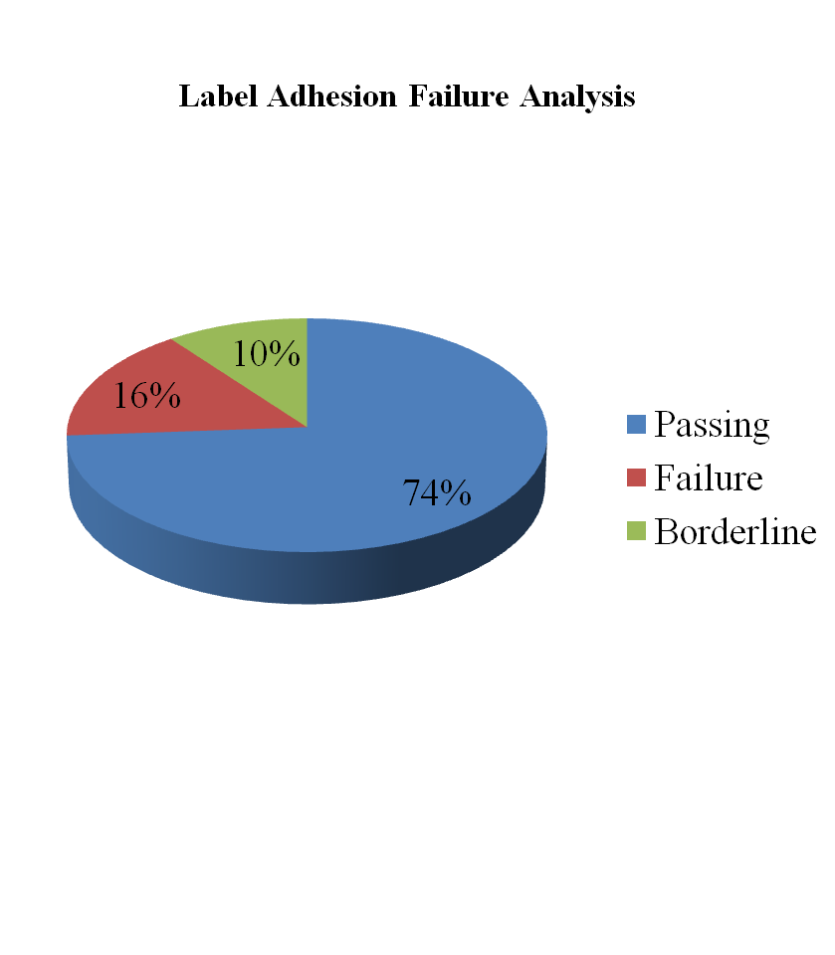
ANSI MH10.8.7 Test Methodology
264 ANSI MH10.8.7 dynamic pull tests
  42 failures or 14 sets of three repetitive tests
  16% resulted in a failure being detected

Slide 7
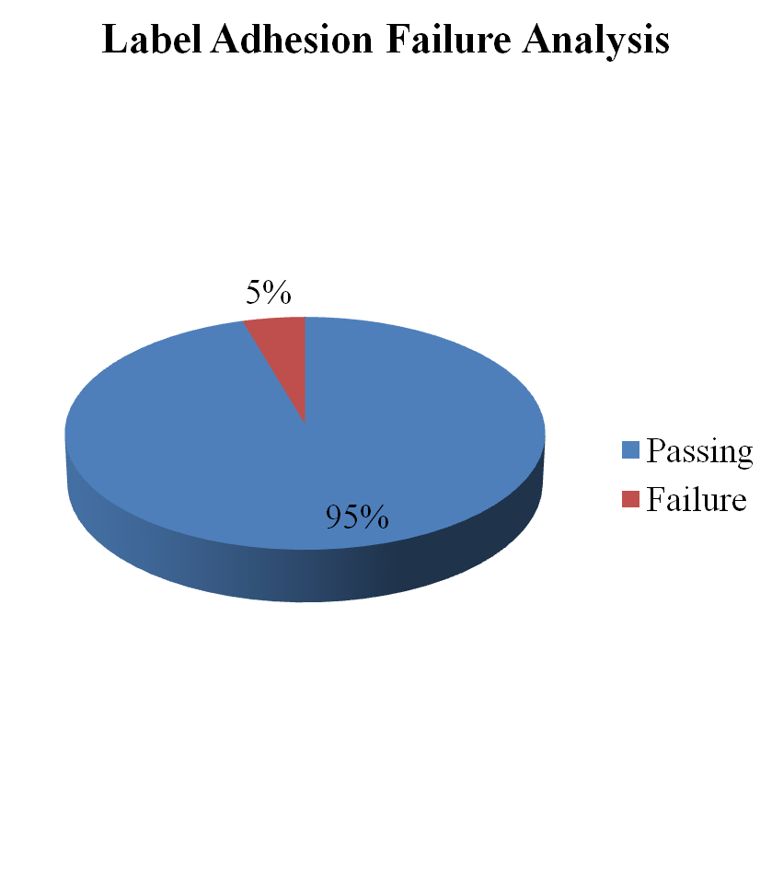
MIL PRF 61002A Test Methodology
264 MIL PRF 61002A static pull tests
  12 failures or 4 sets of three repetitive tests
  5% resulted in a failure being detected

Slide 8
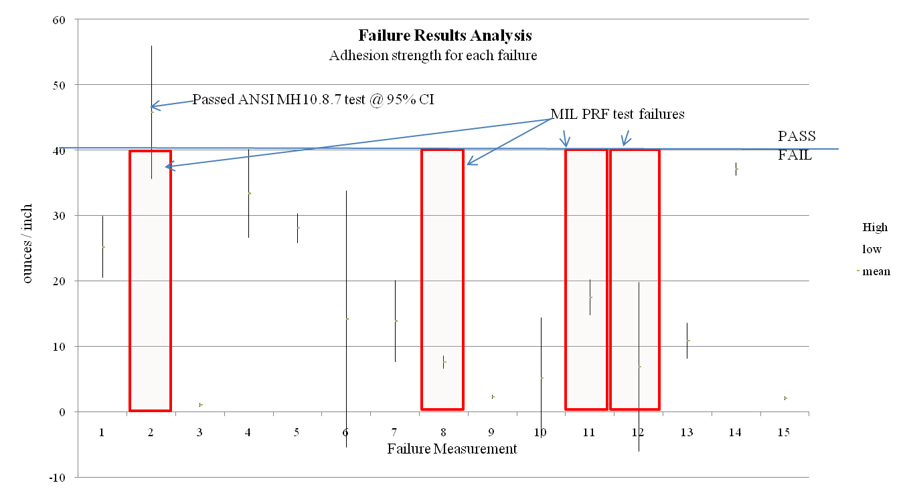
264 Test Failure Analysis

Slide 9
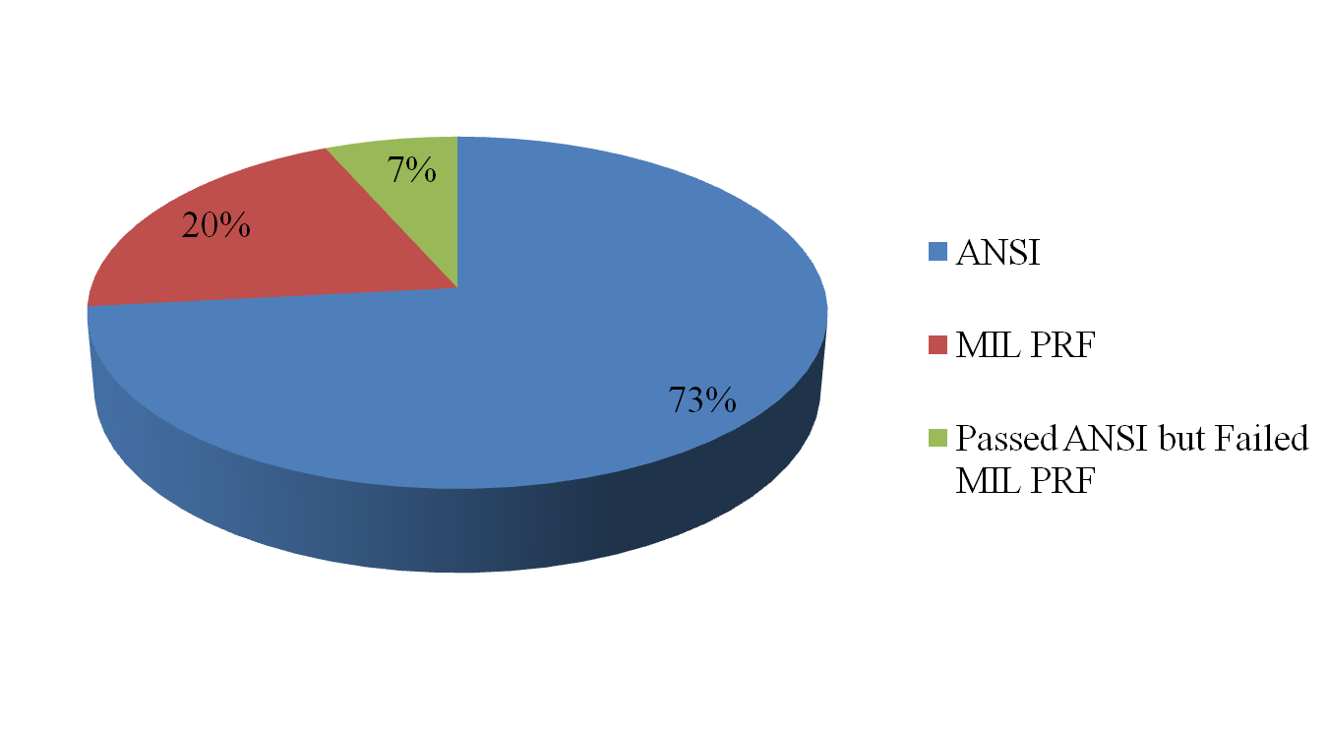
Label Set Failure Analysis of the 15 Recorded Error Sets

